Slide 1

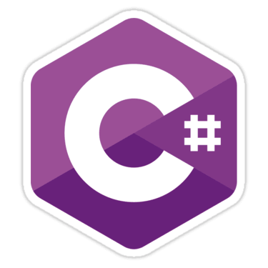



Language Comparison
Java, C#, Python and JS
SoftUni Team
Technical Trainers
Software University
http://softuni.bg

Slide 2

Table of Contents
Variables
Data Types
Printing on the Console
Conditional Statements
Loops
IDE

Slide 3
Have a Question?
sli.do
#fund-common

Slide 4
Declaring Variables in C# / Java
To declare variable in C# / Java you need to use the pattern:
{data type} {variable name} = {value};
C#
Java
int firstNumber = 5;
string name = "Pesho";
bool isPassed = false;
char gender = 'F';
double mathGrade = 5.49;
int firstNumber = 5;
String name = "Pesho";
boolean isPassed = false;
char gender = 'F';
double mathGrade = 5.49;

Slide 5
Declaring Variables in JavaScript
To declare variable in JS you need to use the keyword let:
Examples:
let {variable name} = {value};
let firstNumber = 5;
let name = "Pesho";
let isPassed = false;
let mathGrade = 5.49;

Slide 6
Declaring Variables in Python
Python has no command for declaring a variable
Variables do not need to be declared with any particular type
Examples:
first_number = 5
name = "Pesho"
is_passed = False
math_grade = 5.49

Slide 7



Data Types and Variables

Slide 8
Data Types in C# and Java
Real Number – double, float
Integer – int, long
Text – string, char
Boolean – bool
Other – null
Real Number – double, float
Integer – int, long
Text – String, char
Boolean – boolean
Other – null

Slide 9
Data Types in JavaScript
Data types are not declaring data types
The interpreter does it for you
Data types:
number
string
boolean
Object
null
undefined

Slide 10
Data Types in Python
Variables stores values
Data types:
int
float
str
boolean
In Python, the data type is set when you assign a value to a variable

Slide 11

Printing on the Console

Slide 12
Printing on the Console in C#
Printing content and then going to a new line
Printing content and staying on the same line
string name = "Pesho";
Console.WriteLine(name);
string name = "Pesho";
Console.Write(name);

Slide 13
Printing on the Console in Java
Printing content and then going to a new line
Printing content and staying on the same line
String name = "Pesho";
System.out.println(name);
String name = "Pesho";
System.out.print(name);

Slide 14
JavaScript / Python
JavaScript
Printing content and going to a new line
You can't print without going to a new line
Python
Printing content and going to a new line
Staying on the same line
let name = "Pesho";
console.log(name);
print("Pesho")
print("Pesho", end='')

Slide 15
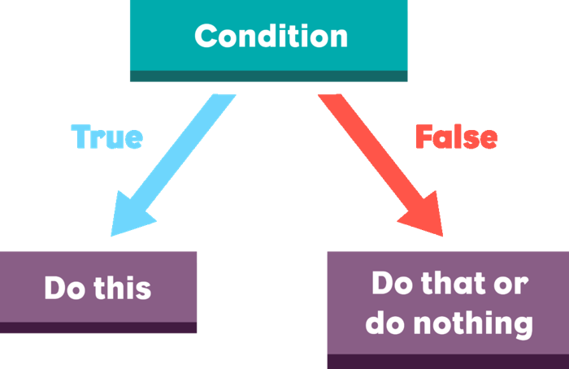
Conditional Statements

Slide 16
C# and Java
C#
Java
double grade = 4.50;
if (grade >= 3.00)
{
Console.WriteLine("Passed!");
}
else
{
Console.WriteLine("Failed!");
}
double grade = 4.50 if (grade >= 3.00) {
System.out.println("Passed!");
} else {
System.out.println("Failed!");
}

Slide 17
JavaScript and Python
JavaScript
Python
let grade = 4.50;
if (grade >= 3.00) {
console.log("Passed!");
} else {
console.log("Failed!");
}
grade = 4.50
if grade >= 3.00:
print("Passed!")
else:
print("Failed!")

Slide 18

Loops

Slide 19
While Loop in C# and Java
C#
Java
int counter = 0;
while (counter <= 9)
{
Console.WriteLine(counter);
counter++;
}
int counter = 0;
while (counter <= 9) {
System.out.println(counter);
counter++;
}

Slide 20
While Loop in JS and Python
JS
Python
let counter = 0;
while (counter <= 9) {
console.log(counter);
counter++;
}
counter = 0
while counter <= 9:
print(counter)
counter++

Slide 21
For Loop in C# and Java
C#
Java
for (int i = 0; i <= 9; i++)
{
Console.WriteLine(i);
}
for (int i = 0; i <= 9; i++) {
System.out.println(i);
}

Slide 22
For Loop in JS and Python
JS
Python
for (let i = 0; i <= 9; i++) {
console.log(i);
}
for i in range(0, 10):
print(x)

Slide 23




IDE
Integrated Development Environment

Slide 24

C#
Visual Studio 2017 Community

Slide 25
Java
IntelliJ IDEA

Slide 26
JavaScript
WebStorm

Slide 27

Python
PyCharm

Slide 28
https://softuni.bg/trainings/courses

Slide 29












SoftUni Diamond Partners

Slide 30




SoftUni Organizational Partners

Slide 31




Trainings @ Software University (SoftUni)
Software University – High-Quality Education and Employment Opportunities
softuni.bg
Software University Foundation
http://softuni.foundation/
Software University @ Facebook
facebook.com/SoftwareUniversity
Software University Forums
forum.softuni.bg

Slide 32

License
This course (slides, examples, demos, videos, homework, etc.) is licensed under the "Creative Commons Attribution-NonCommercial-ShareAlike 4.0 International" license

